Slide 1
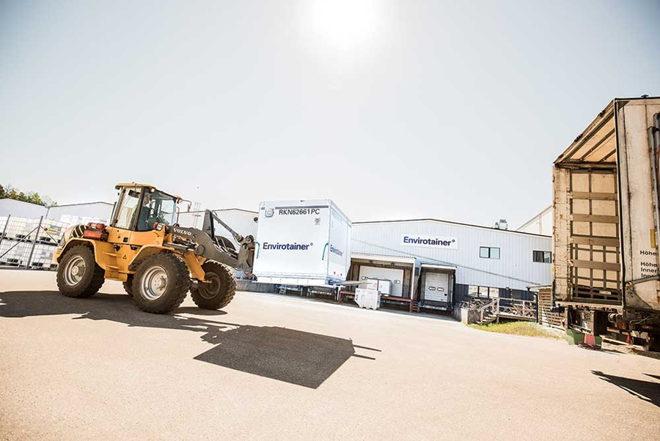

Team Member: Amily Huang, Duo Zhou and Jenny Jiang
Advisor: Ashish Pujari

Slide 2
Agenda
01
Company and Industry Overview
02
Opportunity Statement
03
Goal of Analysis
04
Literature Review Summary
05
Data Information
06
Methodology

Slide 3
Company and Industry Overview

Slide 4
Company Introduction
Expertise
35 years of expertise in pharmaceutical cold chain logistics^{[5]}
Shipped up to 2 million doses of medicine each day
Goal
Safely deliver pharmaceuticals by maintaining integrity and quality^{[8]}
Storage Depot
Pharma’s Client
Manufacture
Trucks
Planes
Trucks
Pharma
Pharma
Forwarder
Airlines
Forwarder
Destination
DHL
UPS
FedEx
American Airlines
Air Canada
Delta Airlines
Hospital
Clinic
Pharmacy

Slide 5
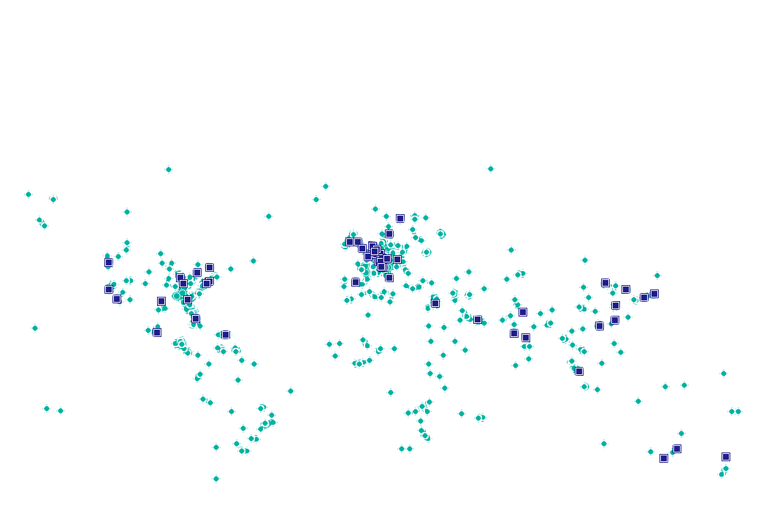
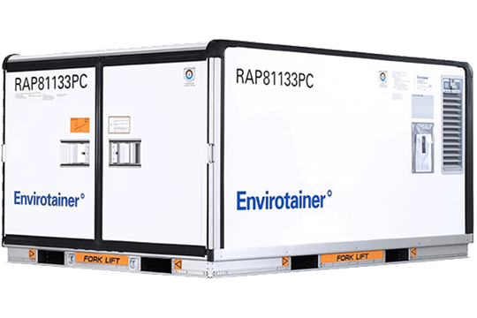
Company Introduction
Solution
Partner
Manufacture and lease certified containers
Offer services for validation, planning, shipping, and follow-up of temperature-controlled air transport
50+ service stations covering 300 airports and 2,000 trade lanes around the world^{[5]}
Partnered with 100 airlines and 40 logistics companies and trained 16,000 stakeholders^{[5]}

Slide 6
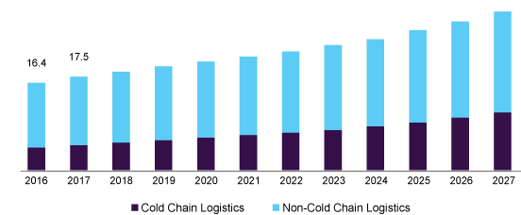
Industry Overall Market Size
US Pharmaceutical logistics market size
Pharmaceutical cold chain logistics market size increase year by year^{[7]}
North America and Europe are responsible for this global revenue^{[9]}
Asia is catching up fast^{[9]}
$16.4 billion
$17.5 billion

Slide 7

Industry Challenges & Future
Pharmaceutical logistics need to optimize effectiveness rather than efficiency since product waste drives up prices and create shortages^{[6]}
Many companies currently did not use temperature and location tracking container^{[6]}
Companies still need to improve their container qualification and management process^{[9]}

Slide 8
Opportunity Statement

Slide 9
Opportunity Statement
Benefit & Cost
Desired State
Current State
Benefit
Reduce cost from failure
Better container allocation and positioning and trade lane set ups
Improve training process
Cost
Increase cost due to shipment failure of high-value pharmaceuticals
Hard to maintain their promise to customers that containers will always be prepared and arrive within 24h
Temperature deviation during transportation is still a problem
Most excursions are due to manual error and unpredictability
Pharmaceutical manufacturers lose 15 billion per year in product cost due to cold chain failure^{[6]}
The existing model predicts failures using only the container performance data based on a manually set criterion
Reduce failure rate for better failure prediction
Gain insights on the demand based on the trade lanes
Gain insights on customers and forwarders’ container handling performance
Notes:
Benefit:
Every container 價值高, 降低failure rate could reduce cost
The problem of temperature excursions is widespread. Pharmaceutical manufacturers lose $15 billion per year in product costs due to cold-chain failures, and that doesn’t include resupply and investigation costs.

Slide 10
Goal of Analysis

Slide 11
Predictive Container Performance Analytics Model:
Utilizing the original format and derivations (gradience, ratio, etc.) from logged container parameters data and Trade Lane & Shipment order data to develop a supervised classification model with imbalanced label classes.
Response Variable (Binary)
1 for Any Temperature Deviation + Selected Alarms
0 for Normal Instances
Predictive Features for e-container & t-container:
Shipment Duration
Distance traveled (TBD)
Weighted Average Ambient Temperature
Set temperature
Duration of out-of-design ambient temperature
Number of Doors Open
Origin & Destination (TBD)
Forwarder Names
Customer Names
Predictive Features for e-container only:
Average battery level during the trip
Unit of Analysis
Each Observation contains information regarding a unique container movement from origin to destination

Slide 12
Additional Analysis
Customer and forwarder container handling behavior analysis
Conduct Analysis on how the number of failures changes over all the forwarders and customers.
Provide Recommendation on which forwarders/airlines need additional training
Trade lane demand analysis
Rank demand by trade lanes
Plot time series graphs of overall demand and demand by top trade lanes
Forecast all the time series
Descriptive Analysis of Different Feature’s Impact on Failures
Conduct Analysis on how the number of failures changes by trade lane, by season and by duration of the shipments

Slide 13
Literature Review

Slide 14
Predictive Maintenance / Failure (Outlier) detection of the Pharma Cold Chain Industry Consists of Three Main Categories: ^{[1], [3], [6], [7], [9]}
Descriptive Analytics using historical anomaly data and then intervene in those anomalous cases
Predictive Analytics using aggregated historical Data and Machine Learning/Deep Learning to give early warning and insights on pending shipments
IIoT (Industrial Internet of Things) Predictive Analytics combining real-time and historical data with AI, Deep Learning/Machine Learning to provide end to end real-time warning/insights during shipments.
Our Main Analysis of Envirotainer Capstone:
Utilizing container performance data (CDD) &
trade lane information data (ELOS)
Container failure descriptive analysis
Container failure predictive analysis
Supervised Outlier (Failure) Detection –
Classification Problem with Imbalanced Dataset

Slide 15
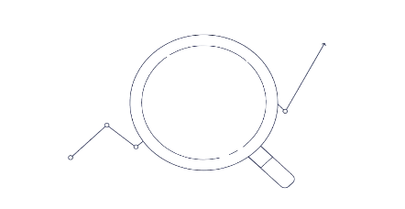
How is supervised outlier detection different from classification^{[2]}?
Supervised outlier detection is a difficult, special case of the classification problem
Challenges of supervised outlier detection
01.
Class imbalance
Optimization of absolute accuracy is not meaningful
Contaminated normal class instances
In many real scenarios, only outliers are labelled, and the remaining “normal” data contains some unlabelled abnormalities
Partial training information
In many applications, examples of one or more of the anomalous classes may not be available
02.
03.

Slide 16
Evaluation of supervised outlier detection^{[2]}
Evaluation and model construction are closely related in all learning problems.
Evaluation of supervised outlier detection
Evaluation weigh the misclassification of outliers differently from that of normal instances
The basic assumption behind this fact:
It is more costly to misclassify outliers as compared to normal instances
Evaluation should be cost-sensitive accuracy
Based on the understanding of the evaluation mechanism, the following types of methods are considered:
Cost-sensitive learning
Adaptive re-sampling
Threshold selection

Slide 17
Methods for supervised outlier detection^{[2]}
Cost-sensitive learning
Off-the-shelf classification algorithms are used
The loss function of the classification algorithm is modified to weight the classification errors differently for normal instances and outliers
The misclassification cost is added to the loss function.
Many classification algorithms can be modified to account for costs:
Bayes Classifier
k-Nearest Neighbor
Random Forest
Support Vector Machines
Boosting methods
Adaptive re-sampling
The data are re-sampled in order to magnify the relative proportion of the outliers.
Oversample outliers
Under-sample normal instances
The classification algorithm is learned on the re-sampled data
Threshold selection
Based on a specific error metric only (i.e. False Negative)

Slide 18
Data Information

Slide 19
Data Sets | Features | Meta Data | Size
Container Logged Data | Container Temperature | Temperature inside container | TBD
 | Different Ambient Temperature Range Duration | Amount of time the container experiences at different ambient temperature range
 | Set Temperature | Desired inside temperature set by clients
 | Set Temperature limit | The allowed deviation limit based on set temperature (+/-3 ⁰C)
 | Power Percentage During the Shipment (Mean, Min and Max) | Amount of power left in the battery
 | Number of Door Openings
 | Different Parts Failure Alarms
Trade Lanes & Shipment Information | Shipment Duration |  | TBD
 | Customer Name | Delivery Initiators (i.e. Pharma Company, Hospital)
 | Forwarder Name | Transportation companies (i. e. Airlines, FedEx, UPS)
 | Container Number | Unique for each container
 | Order Number | Unique for each shipment
 | Origin and Destination
2-3 Years of integrated Container Logged parameters and Trade Lane & Shipment Information Data with preliminary aggregation.
Each year consists of approximately 50,000 container movements and each shipment could use multiple containers.

Slide 20
Methodology

Slide 21
Main Analysis:
Supervised Machine Learning Classification with imbalanced label classes.
Algorithm ^{[2] [3] [4]}
Various machine learning supervised classifiers (GLM, Random Forest, Boosting, Bayes, SVM, ensemble etc,) with
Cost-sensitive Learning
Adaptive Re-sampling (Under-sampling of normal instances is preferred)
Threshold Selection Based on False Negative Only (Failures = Positive)
The best model will be selected using False Negative

Slide 22
Additive Analysis:
Customer and forwarder container handling behavior analysis
Count the frequency of failures for each forwarder and customers, identifying forwarders and customers with a high frequency of failures
Compare the number of failures of different forwarders and customers by setting other factors the same
Trade lane demand analysis
Using Facebook prophet with holiday and major health events model packages
Descriptive Analysis of Different Feature’s Impact on Failures
Count frequency of failures through different trade lane, different season, and different range of shipment duration to see how each features impact on failures

Slide 23
References
[1] Cece, S. (2020, April 6). Pharma needs a smarter cold chain. Pharma Manufacturing.
https://www.pharmamanufacturing.com/articles/2020/pharma-needs-a-smarter-cold-chain/
[2] Charu C. Aggarwal (2017). Outlier Analysis. Springer International Publishing
[3] Comes, T., Bergtora Sandvik, K. and Van de Walle, B. (2018), "Cold chains, interrupted: The use of technology and information for decisions that keep humanitarian vaccines cool", Journal of Humanitarian Logistics and Supply Chain Management, Vol. 8 No. 1, pp. 49-69.
[4] Failures in temperature-controlled logistics cost biopharma industry billions. (2019, July 29). Air Cargo News. https://www.aircargonews.net/sectors/pharma-logistics/failures-in-temperature-controlled-logistics-cost-biopharma-industry-billions/
[5] Our Eco-system. (2020, October 29). Envirotainer. https://www.envirotainer.com/about-us/eco-system/
[6] “Pharma needs a smarter cold chain, How IIoT can help the industry avoid temperature excursions”, By Sam Cece, Founder, President, CEO, Swift Sensors, Apr 06, 2020. https://www.pharmamanufacturing.com/articles/2020/pharma-needs-a-smarter-cold-chain/
[7] Pharmaceutical Logistics Market Size Report, 2020-2027. (2020, May). Grand View Research. https://www.grandviewresearch.com/industry-analysis/pharmaceutical-logistics-market
[8] S. (2018, November 12). The Rules for Shipping Pharmaceuticals You Need to Know | Ship ABCO. ABCO Transportation. https://www.shipabco.com/the-rules-for-shipping-pharmaceuticals-you-need-to-know/
[9] The Role of Cold Chain Logistics in the Pharmaceutical Industry. (2020, August 25). VRR. https://vrr.aero/this-is-vrr/news/2020/the-role-of-cold-chain-logistics-in-the-pharmaceutical-industry/
[10] Today’s pharma cold chain is going cryogenic. (2020, September 29). Pharmaceutical Commerce. https://www.pharmaceuticalcommerce.com/cold-chain-focus/todays-pharma-cold-chain-is-going-cryogenic/
[11] Xu, W., Zhang Z, K., Gong D. and Guan X. (2014), " Neural network model for the risk prediction in cold chain logistics", international journal of multimedia and ubiquitous engineering.
Notes:
Benefit:
Every container 價值高, 降低failure rate could reduce cost
The problem of temperature excursions is widespread. Pharmaceutical manufacturers lose $15 billion per year in product costs due to cold-chain failures, and that doesn’t include resupply and investigation costs.

Slide 24
Q&A
Thank You

